Slide 1
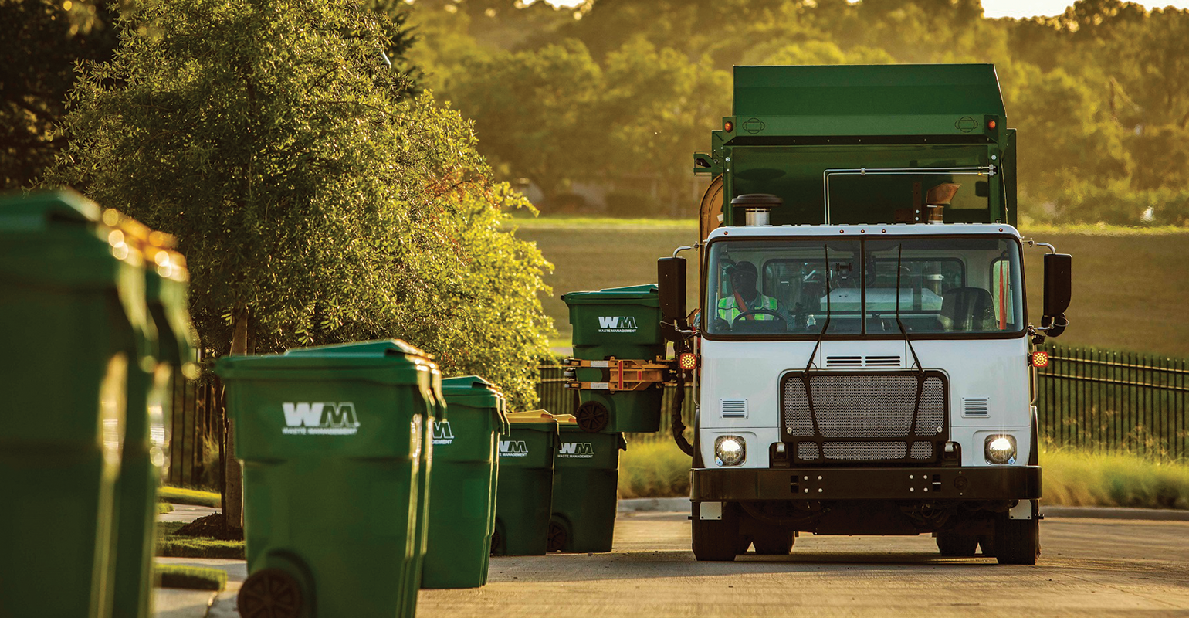
Blockchain for Waste Management in Smart Cities
By
Rahana Joshy
Roll No – 29
MCA S4 B

Slide 2
Introduction
Smart cities have the potential to overcome environmental problems caused by improper waste disposal by improving human health, protecting the aquatic ecosystem, and reducing air pollution. However, today’s systems, approaches, and technologies leveraged for waste management are manual and centralized. This fact makes them vulnerable to manipulation and the single point of failure problem. Also, a large portion of the existing waste management systems within smart cities fall short in providing operational transparency, traceability, audit, security, and trusted data provenance features. In this project, we are going to explore the key role of blockchain technology in managing waste within smart cities as it can offer traceability, immutability, transparency, and audit features in a decentralized, trusted, and secure manner.
.

Slide 3
RELEVANCE
The key point in waste management for smart cities is that municipalities that are responsible for waste management in cities have various needs, and latest technologies present efficient and proper waste management solutions for sustainable municipal waste management.
That’s why this project provides with some of the needs and efficient solutions for municipal waste management.

Slide 4
Needs of Smart cities in waste management
One of the need of municipalities is that municipalities have waste trucks and drivers of that waste trucks. The municipalities need to control that their waste trucks proceed in the most efficient route possible.
Another need of municipalities in waste management is that they need to cooperate with their citizens in waste management processes.
The responsive person of the waste management in a municipality needs to control waste management processes from a practical point of view. So, all-in-one technology will be very beneficial for the municipalities.

Slide 5
Existing System
Proposed System
Manual
Fraudulent activities
Single point of failure problem
Idling Workforce
Inefficient deployment of the Fleet & Workers
Digitalised
Monitoring of drivers and other workers.
Helps the authorities with the single monitoring dashboard
Detailed analysis reports in Web Application
Security

Slide 6
TECHNOLOGIES USED
Blockchain is a decentralized technology that can assist in securing data and transactions by storing and executing them in a trustful manner. It follows a Peer-to-Peer (P2P) architecture to store and process data in a highly reliable, secure, transparent, and trusted way. Blockchain technology allows and provides incentives to the miners to participate in the consensus process to validate the transactions and create new blocks. Ethereum is a decentralized and open-source permissionless blockchain platform that allows digitizing and tracking assets through smart contracts.
Smart contracts represent programs stored on the blockchain with terms of agreement between participants of waste management processes. They automatically execute and trigger events after meeting predetermined criteria in the agreement. Also, they assist the stakeholders in performing business operations in a faster, cheaper, and secure way compared to traditional systems that require intermediaries to commit the business operations.

Slide 7
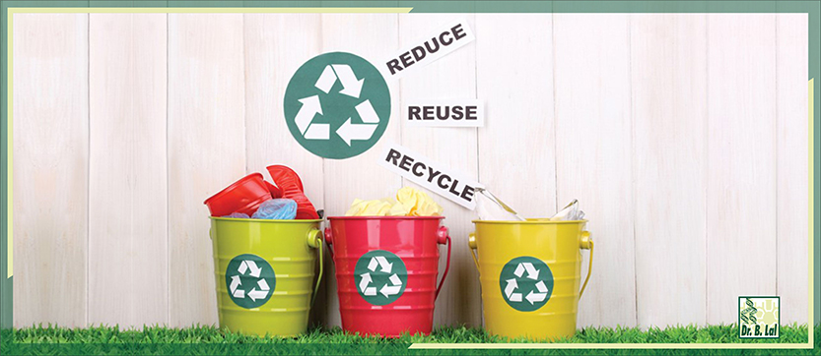
Benefits of blockchain technology in waste management
Data loss prevention
Fraud and Manipulation prevention
Data Security
Data consistency and immutability
Cost or Resource effectiveness
Supply chain transparency

Slide 8
Ganache CLI is the latest version of TestRPC : a fast and customizable blockchain emulator. It allows you to make calls to the blockchain without the overheads of running an actual Ethereum node. Transactions are “mined” instantly.
The web3.py library provides a programming language-specific client interface used to interact with data that is already present in the Ethereum blockchain.
Django is a high-level Python web framework that encourages rapid development and clean, pragmatic design. Built by experienced developers, it takes care of much of the hassle of web development, so you can focus on writing your app without needing to reinvent the wheel. It’s free and open source.

Slide 9
MAIN ROLES
Municipality Employee (Admin)
Registration
Login
View notifications
Add users (Customer, Inspector, contractor, Driver, Police)
View users
View payments and customer requests and their contractor details
Assign inspectors to location
Customer
Login
Request pick up
Make payment
View accepted requests
Add complaint to police

Slide 10
Police
Login
View complaint
Notify inspector
Inspector
Login
Receive request notification from Admin
Approve request
Contractor
Login
View and accept request
Add/View driver
Assign driver
Get payment from Admin
Driver
Login
View assigned tasks
Update status of task

Slide 11
Hardware Specification
Processor: i5
RAM: 4GB (Minimum)
Hard Disk: 250GB or above
Mouse
Keyboard
Software Specification
Tool: Python IDLE
Python: version3
Operating System: Windows 10
Front End: HTML,CSS,JS
Back end: Django (Python)

Slide 12
THANK YOU!

